Slide 1
Simultaneous Simulation and Optimization: An Introduction to Fourier Optics with Python and PyTorch Implementations
Marshall Lindsay

Slide 2
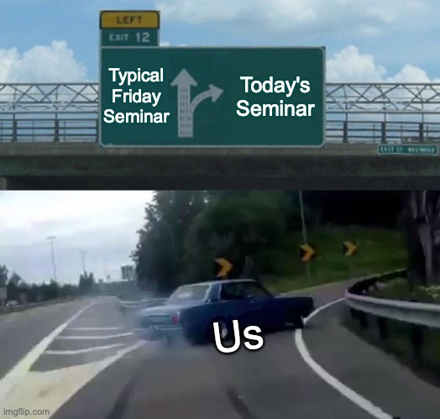
Today’s Seminar
Shameless Research Plug
Objectives
Introduction to a huge field of research
Breadth vs Depth
Physics Problem + Computational and AI problem
Provide implementation of forward physics problem
Incorporating physics directly into the network architecture

Slide 3
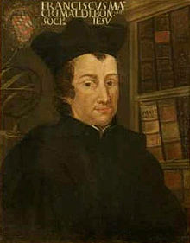
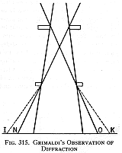
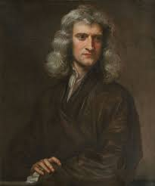
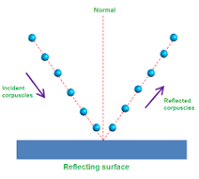
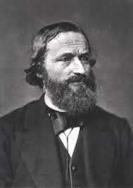
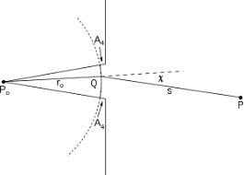
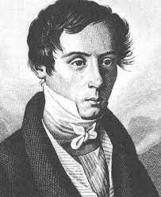
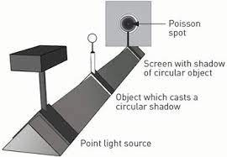
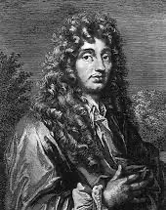
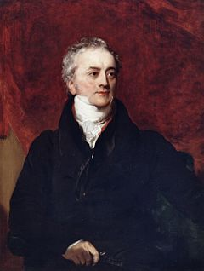
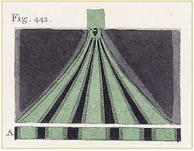
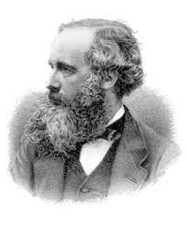
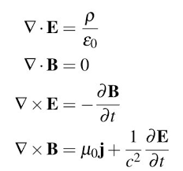
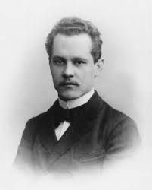
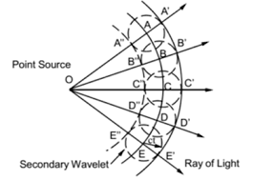
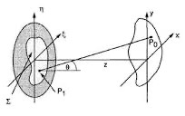
Historical Introduction to the Wave Nature of Light
Francesco Grimaldi (1665)
Isaac Newton
(1704)
Augustin Fresnel (1818)
Gustav Kirchhoff (1882)
Christian Huygens (1678)
Thomas Young
(1804)
James Maxwell
(1860)
Arnold Sommerfeld (1894)
Notes:
Grimaldi – Experimental observation of diffraction.
Christian Huygens – Proponent of the wave nature of light. Decomposing a wave envelope into a infinite set of secondary sources forms.
Isaac Newton – Favored the corpuscular theory of light. His follows support this view and progress on the wave nature of light and for 100 years progress on the wave nature of light was impeded.
Thomas Young – Introduced the idea of optical interference. This idea was radical as it implied you could add light to light and get darkness.
Augustin Fresnel - Combined Huygens secondary wavelets with Youngs interference to form the first mathematical description of diffraction. This theory made great predictions of diffraction patterns. Presented this work the award committee of French Academy of Sciences. It was here that the French mathematician Simeon Poisson refuted the work by showing how it predicted a bright spot in the shadow of an opaque disk. The chair of the committee Francois Arago performed the exact experiment and was shocked to find the bright spot in the shadow as Fresnel had predicted. Clearly Fresnel won the academy’s award.
James Maxwell – Finally identified light as not just a wave but an electromagnetic wave and provided the now famous Maxwell’s equations.
Gustav Kirchhoff – Combined the ideas of Fresnel and Huygens with Maxwells equations to show they direct consequences of the wave nature of light as described by Maxwell. He called this formulation of diffraction the Huygens-Fresnel Principle.
Arnold Sommerfeld – (Along with Lord Rayleigh) Found and fixed some mathematical inconsistencies with Kirchhoff’s formulation of diffraction. Put forth the Rayleigh-Sommerfeld diffraction theory.

Slide 4
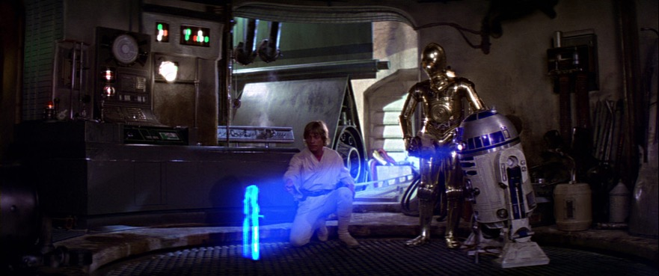
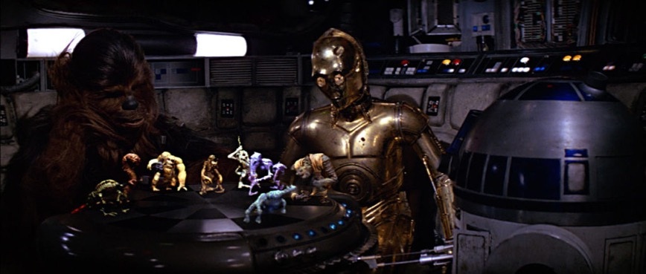
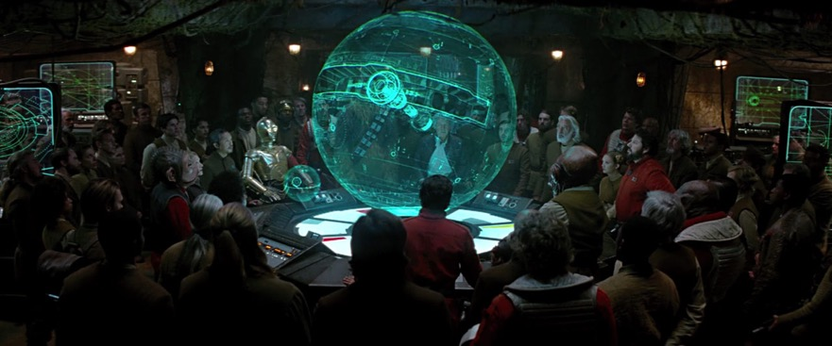
Of Course Light is a Wave – So What?
HOLOGRAMS
Close, but not quite…

Slide 5
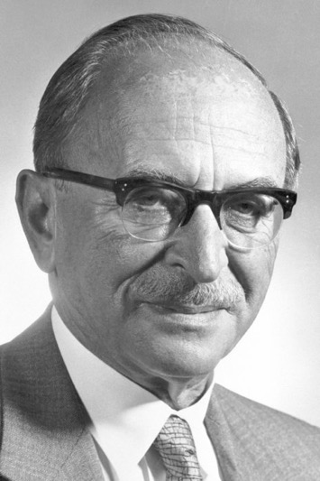
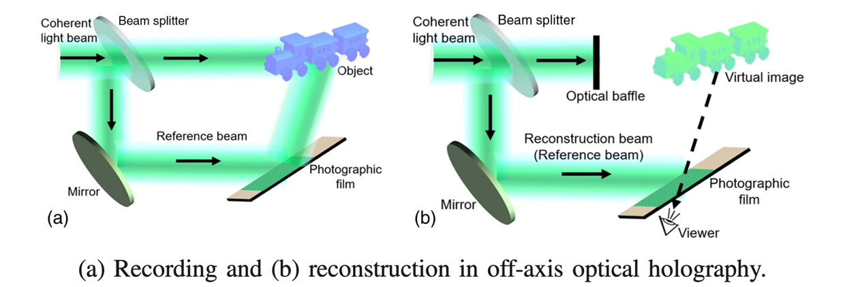
Denis Gabor and the 1971 Nobel Prize in Physics
Denis Gabor won the 1971 Nobel Prize in physics “for his invention and development of the holographic method” which he formulated in 1948.
A hologram is a 'whole image' which contains both amplitude and phase information of the wavefront. It encodes the 3D nature of the object. When properly illuminated, reconstructs the 3D 'object'.

Slide 6
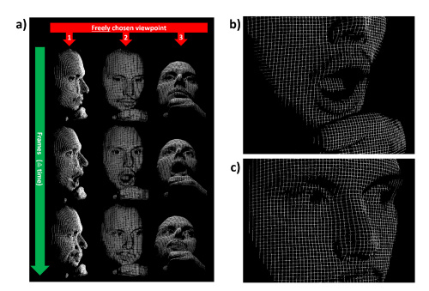
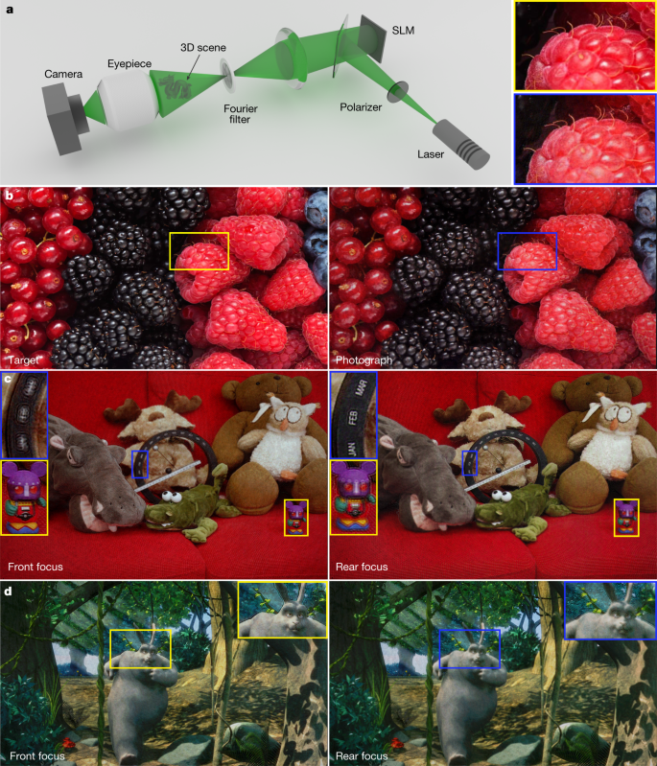
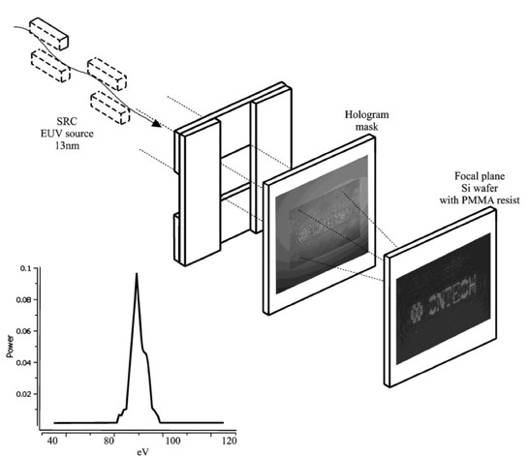
Holography Examples
3D Point Cloud Reconstruction
Photorealistic 3D Images
Arbitrary recording, simulation, and production of 3D wavefronts!
Single Shot UV Lithography

Slide 7
The Context for Fourier Optics
The mathematics of holography is Fourier optics.
Linear Algebra
Neural Networks
Fourier Optics
Holography
Fourier optics allows us to simulate the propagation of scalar electromagnetic waves.
Replacing the standard mathematics of the Neural Network with Fourier optics allows for simultaneous simulation and optimization.

Slide 8
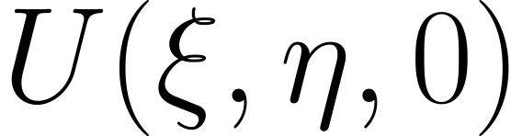
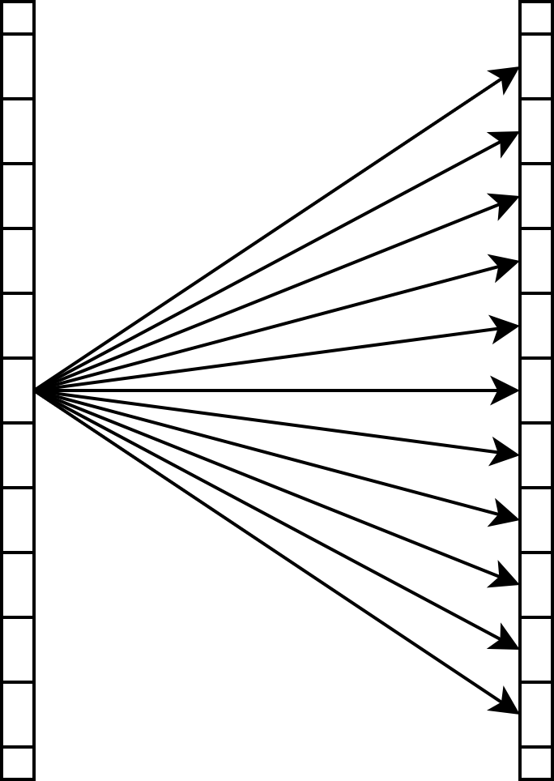
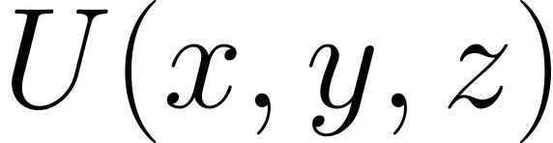
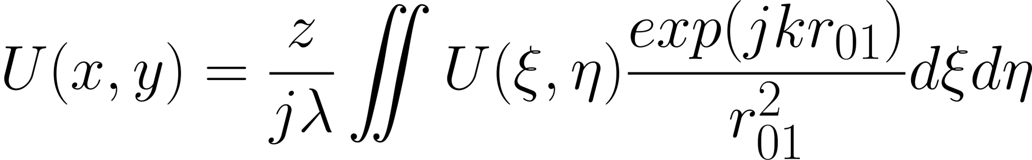
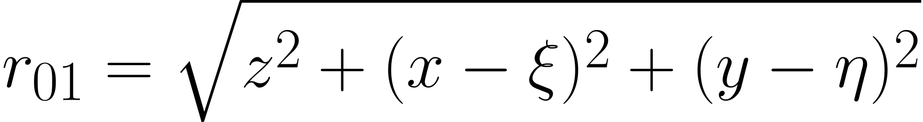
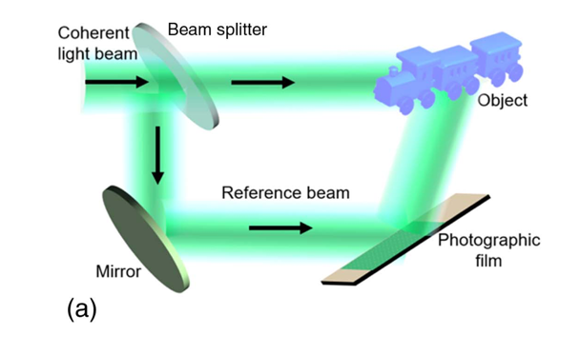
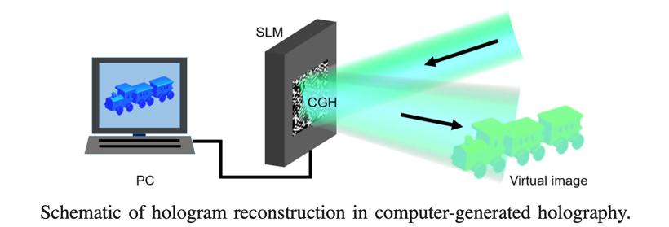
Fourier Optics
Before 1900
1965 – Popularization of the FFT algorithm
1967 – Goodman Applies FFT to solve
No longer need real object to create holograms. We can simply use computer generated models and wavefronts.
Notes:
U(x,y) = \frac{z}{j \lambda}\iint U(\xi,\eta) \frac{exp(jkr_{01})}{r_{01}^2}d\xi d\eta
r_{01} = \sqrt{z^2 + (x-\xi)^2 + (y-\eta)^2}
U(x,y,z) = \frac{exp(jkz)}{j\lambda z}exp\left(j\frac{\pi}{\lambda z}(x^2 + y^2)\right) \iint \left[U(\xi,\eta,0) exp\left(j\frac{\pi}{\lambda z}(\xi^2 + \eta^2) \right ) \right ]exp\left(-j\frac{2\pi}{\lambda z}(x\xi + y\eta) \right )d\xi d\eta
U(x,y,z) = \mathcal{F}^{-1}\left\{ \mathcal{F}\{U(\xi,\eta,0)\} \times exp\left[j2\pi\frac{z}{\lambda}\sqrt{1-(\lambda f_x)^2 - (\lambda f_y)^2} \right ]\right\}

Slide 9
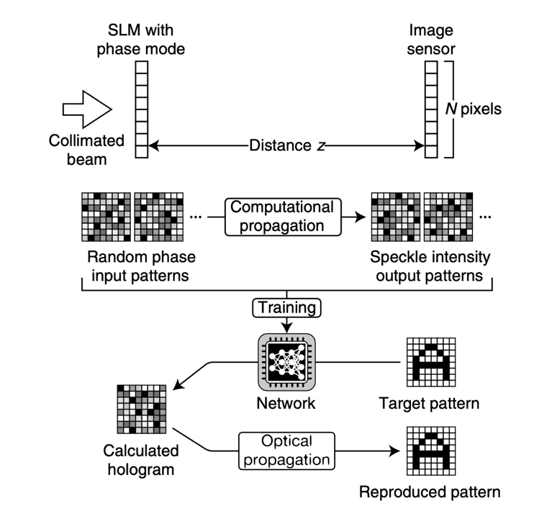
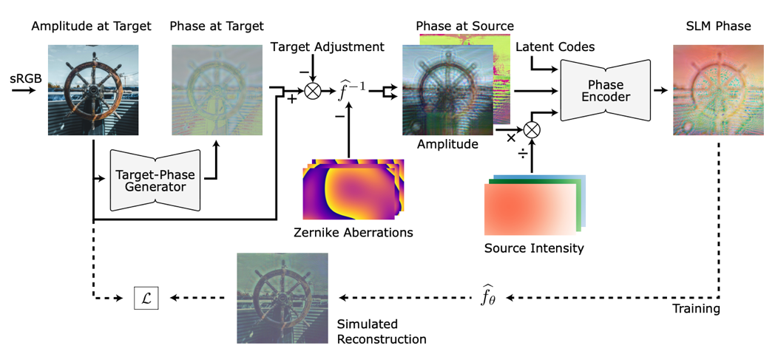
Current AI Simulation and Optimization Techniques
More Physics!

Slide 10
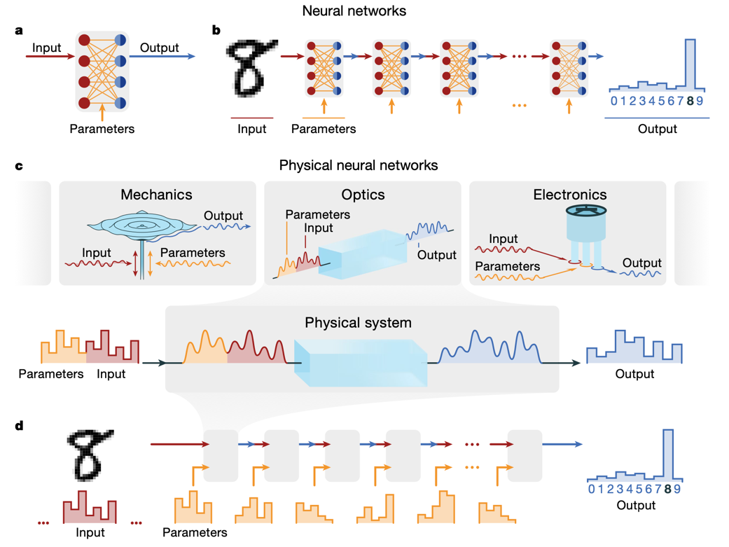
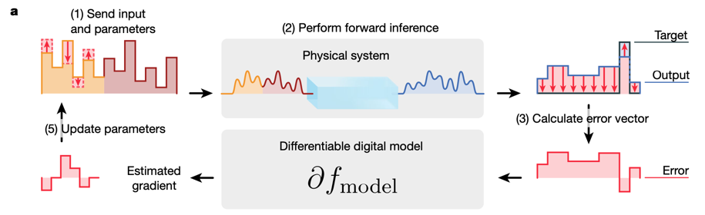
Physics Aware Training
I will demonstrate an example of a differentiable Fourier optics model implemented in PyTorch.
Easier than you might think!

Slide 11
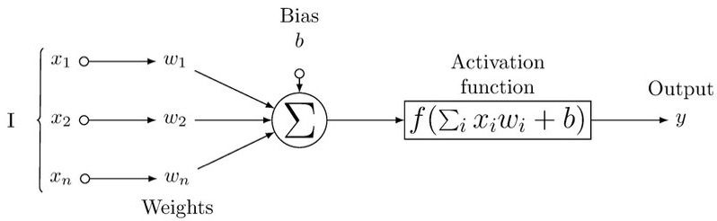
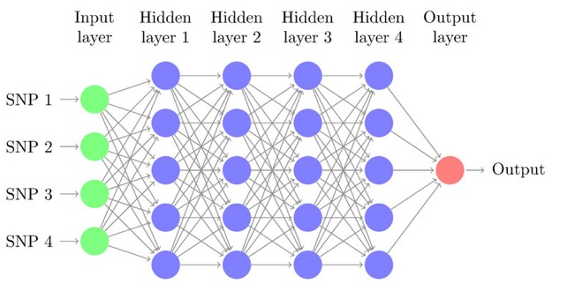
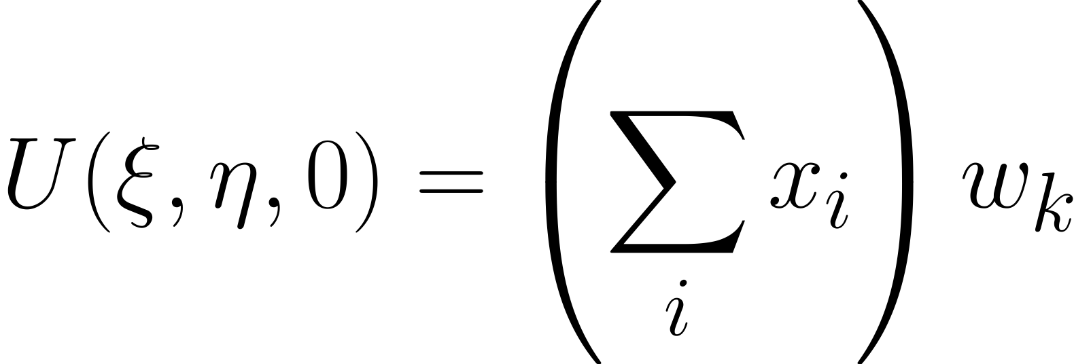
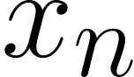
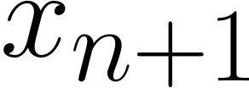
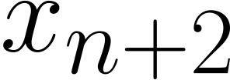
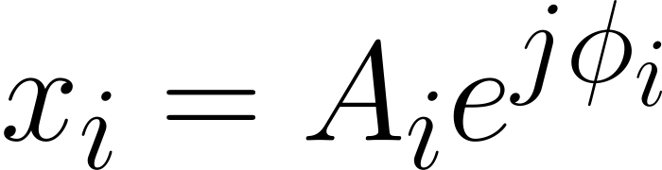
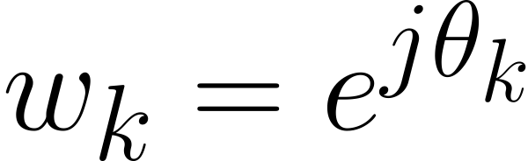
Encoding the Physics
Similar fully-connected structure
Incident Wavefront Interference
'Activation Function'
FO Wavefront Propagation
Phase-Only Wavefront Modulation
Optimizable Quantity!
Complex variables
Notes:
U(\xi, \eta, 0) = \left(\sum_i x_i \right)w_k
w_k = e^{j\theta_k}
U(x,y,z) = f(U(\xi,\eta,0)) = \mathcal{F}^{-1}\left\{ \mathcal{F}\{U(\xi, \eta, 0)\} \times exp \left[ j2\pi \frac{z}{\lambda} \sqrt{1 - (\lambda f_x)^2 - (\lambda f_y)^2 }\right]\right\}

Slide 12
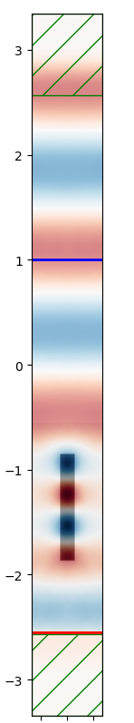
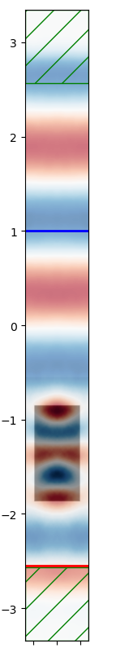
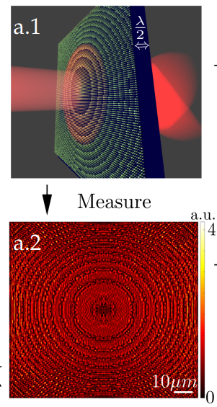
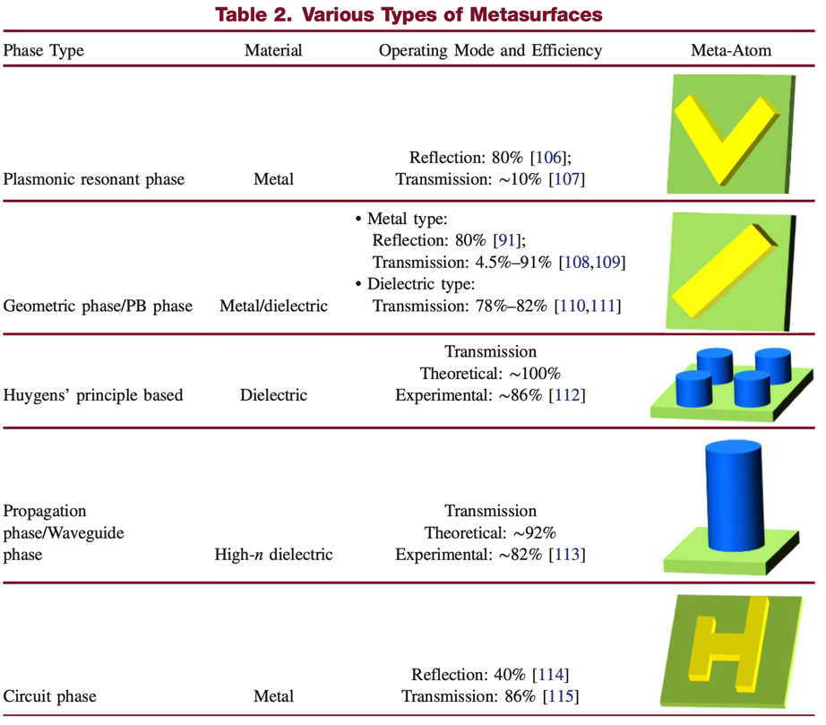
Holography and Metasurfaces

Slide 13
References
https://www.starwars.com/news/6-ways-holograms-play-an-important-role-in-star-wars
Goodman, J. W. "Introduction to Fourier Optics, 4W. H." (2017).
Raeker, B., & Grbic, A. (2021). Lossless Complex-Valued Optical-Field Control with Compound Metaoptics. Phys. Rev. Applied, 15, 054039.
Jiang Jiang, Guofan Jin, and Liangcai Cao, "When metasurface meets hologram: principle and advances," Adv. Opt. Photon. 11, 518-576 (2019)
Ryoichi Horisaki, Ryosuke Takagi, and Jun Tanida, "Deep-learning-generated holography," Appl. Opt. 57, 3859-3863 (2018)
Wright, L.G., Onodera, T., Stein, M.M. et al. Deep physical neural networks trained with backpropagation. Nature 601, 549–555 (2022)
Shi, L., Li, B., Kim, C. et al. Towards real-time photorealistic 3D holography with deep neural networks. Nature 591, 234–239 (2021). https://doi.org/10.1038/s41586-020-03152-0
Yifan Peng, Suyeon Choi, Nitish Padmanaban, and Gordon Wetzstein. 2020. Neural holography with camera-in-the-loop training. ACM Trans. Graph. 39, 6, Article 185 (December 2020), 14 pages. DOI:https://doi.org/10.1145/3414685.3417802
Zhelyeznyakov, Maksym V. et al. “Deep learning to accelerate Maxwell’s equations for inverse design of dielectric metasurfaces.” 2021 Conference on Lasers and Electro-Optics (CLEO) (2021): 1-2.

Slide 14
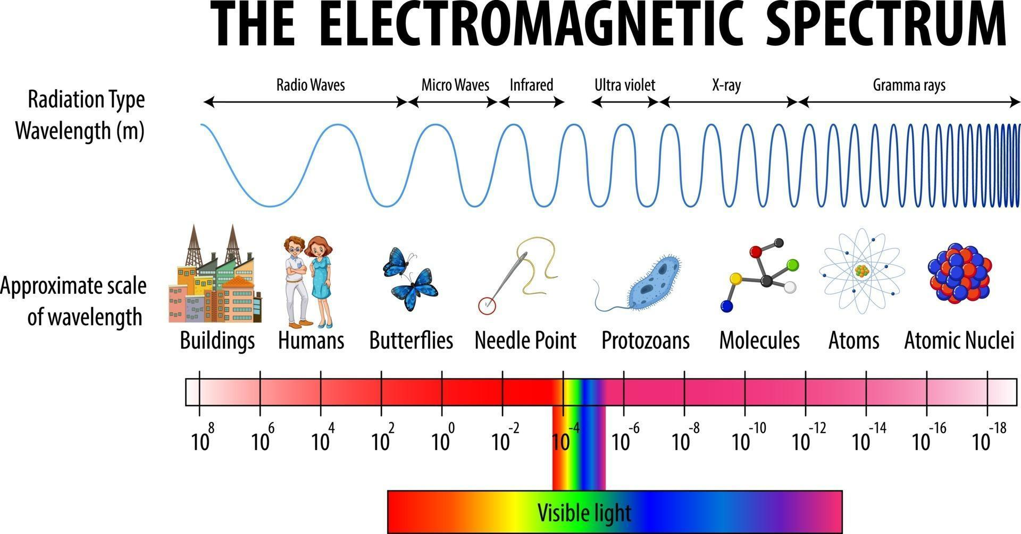
Waves are Waves…

Slide 15
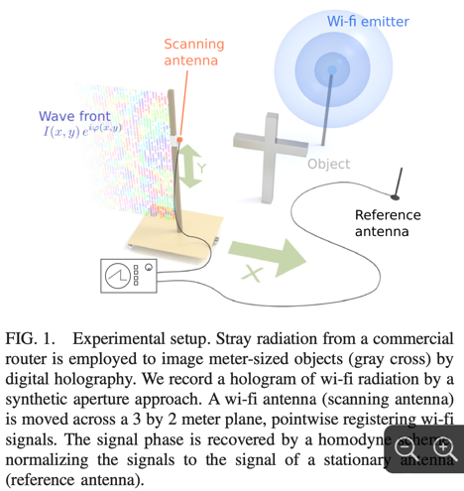



Radio Wave Holography
Synthetic Aperture Imaging – WiFi Radiation
3D Imaging of a 10m ‘Building’

Slide 16



Microwave Holography
Through-wall Imaging
Metasurfaces for Microwave Holographic Images

Slide 17




Infrared Holography
Non-destructive Material Identification
Surface Characterization of Space Reflectors
Thermographic vs Holographic

Slide 18


Visible Holography
Photorealistic Images
3D Point Cloud Reconstructions
Natural DoF Encoding

Slide 19




Ultraviolet Holography
Holographic Lithography
Carbon Nano-tube Imaging
Dynamic Surface Characterization

Slide 20

X-ray Holography
X-Ray Fluorescence Holography (XFH)

Slide 21



X-ray Holography
Doping Element Localization
Crystal Structure and Defect Identification
Radiation Cancer Treatments

Slide 22

Hyperspectral Holography

